Slide 1
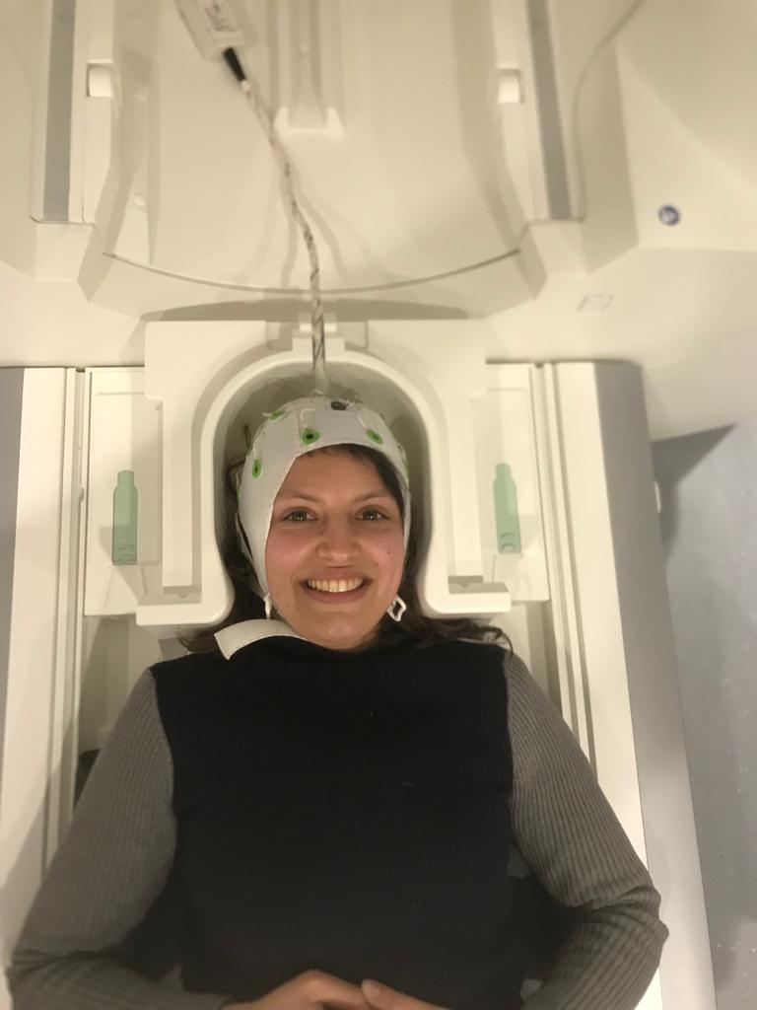
NEUXUS

Slide 2
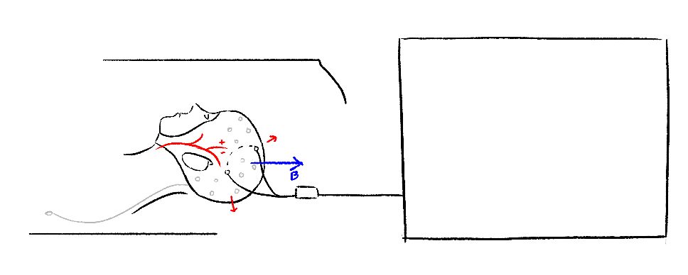
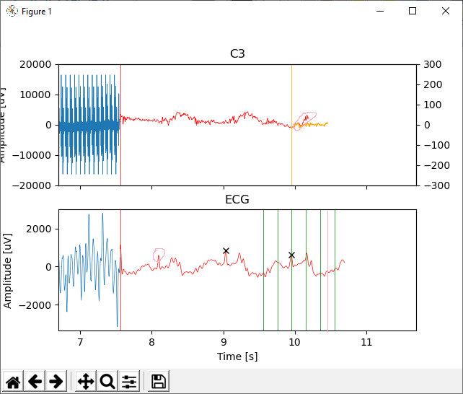
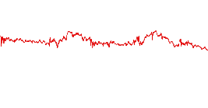
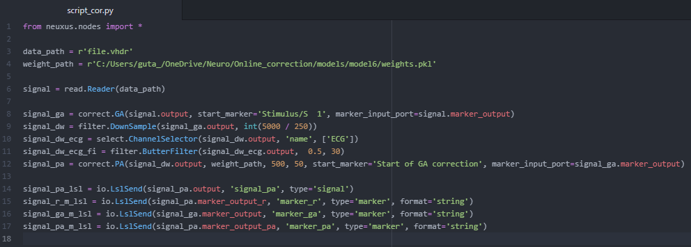
https://github.com/Soraya28/NeuXus/blob/master/examples/mri-artifact-correction/correct.py
EEG-fMRI
EEG Artifacts
Solution
GA correction
chunk template
PA correction
chunk template
GA template
Select
PA template
R-peaks
Select
Average
Average
Predict
Time
Channels
Subtract
Downsample
Filter ECG
Subtract
noisy chunk
clean chunk

Slide 3
How does it work
Uses the LSTM networkd porposed by:
https://dl.acm.org/doi/pdf/10.1145/3341105.3373945
TR template
chunk template
Cardiac cycle template
chunk template
Select
Select
R-peaks
Average
Average
Predict
Time
Channels
Subtract
Downsample
Filter ECG
Subtract
chunk
GA correction
PA correction

Slide 4
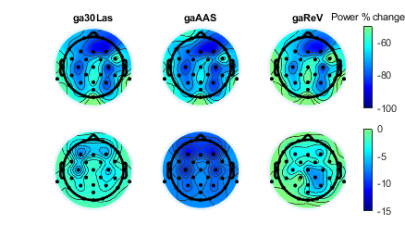
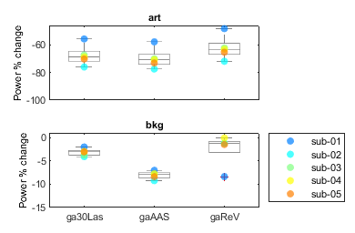
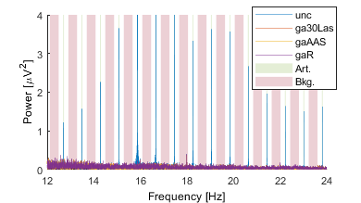
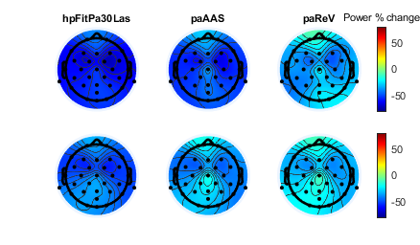
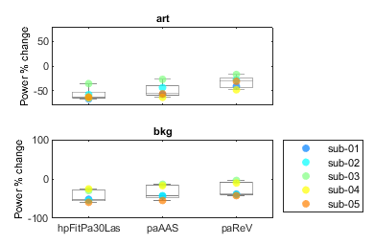
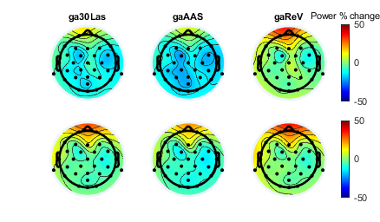
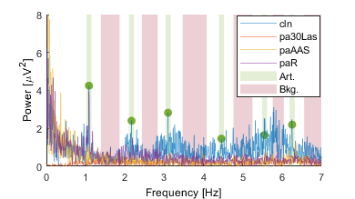
Power % change, in artifact and background bands, between:
Results
GA
Uncorrected (GA+PA) and corrected (PA)
art
art
bkg
bkg
PA
Neuxus recview eeglab
Clean (PA) and corrected (PA)
art
art
bkg
bkg

Slide 5
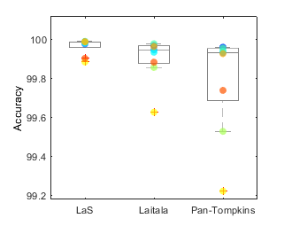
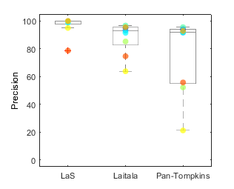
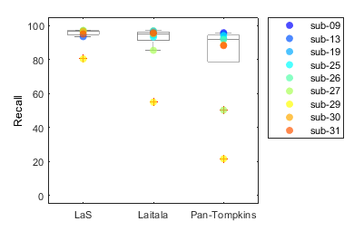
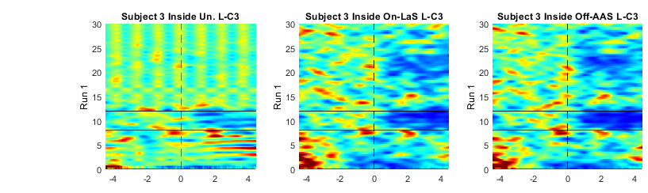
Results
QRS
GA + PA

Slide 6
doc
https://github.com/Soraya28/NeuXus/tree/doc

Slide 7
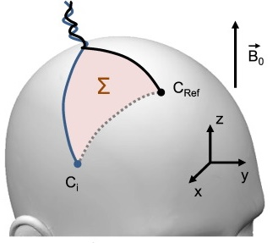
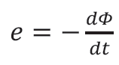
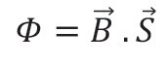
Interactions between EEG and MRI
Lenz-Faraday’s law of induction
Variation of the magnetic flux by unit of time
Magnetic flux depends on the strength and orientation of magnetic field (B) and of closed electrical circuit (S)
S
with
EEG electrodes and wires can be considered as closed electric circuits
In MRI: strong static magnetic field B0 of the magnet + time-varying gradients of magnetic field for image acquisition (Gx, Gy, Gz)
⇨ Motion of EEG wires or electrodes (head motion, vibration, …) in the static magnetic field → ARTIFACTS ∝ B₀
⇨ Variation of magnetic field (gradient for image acquisition) → ARTIFACTS
Notes:
If we come back to our EEG:
EEG électrodes and wired can be seen as a closed electric circuits
In MRI, we have a strong static magnetic field + time varying gradient of magnetic fields used for image acquisition
It means that

Slide 8
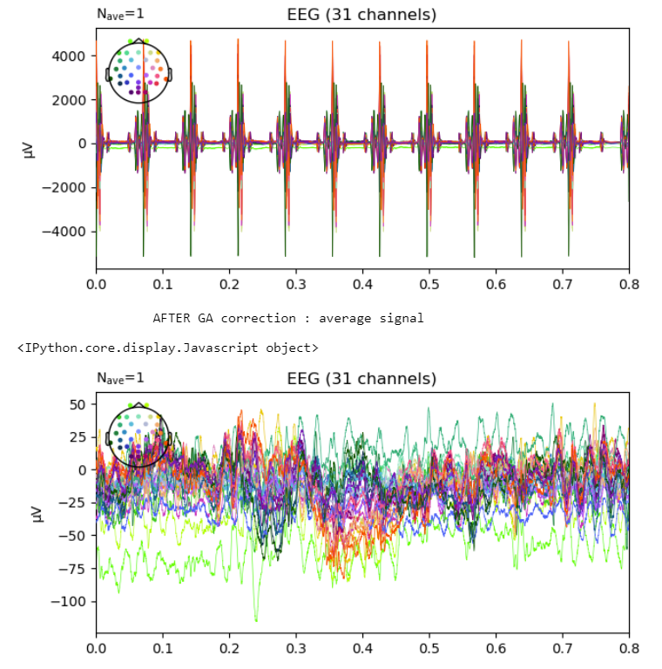
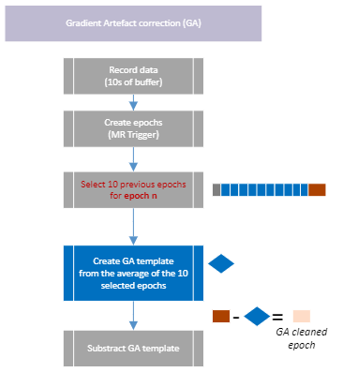
Gradient Artefact (GA)
Produced by temporally varying magnetic fields associated with the switched gradient waveforms used in MRI
Gradient Artefact
Highly stationnary and low variability (except movement)
Can be corrected by substracting an Average template of the artefacts
Example of one epoch :
(1) Before GA correction
(2) After GA correction (AAS)
Notes:
Lenz-Faraday’s law of induction
Any change of the magnetic flux Ф through a closed electric circuit (EEG head) will produce induced electromotive force e

Slide 9
GA correction
https://github.com/Soraya28/NeuXus/blob/doc/neuxus/nodes/correct.py

Slide 10
Artefact
=> PA Cardioballistic artifact: motion of the electrodes/wires after each heartbeat

Slide 11
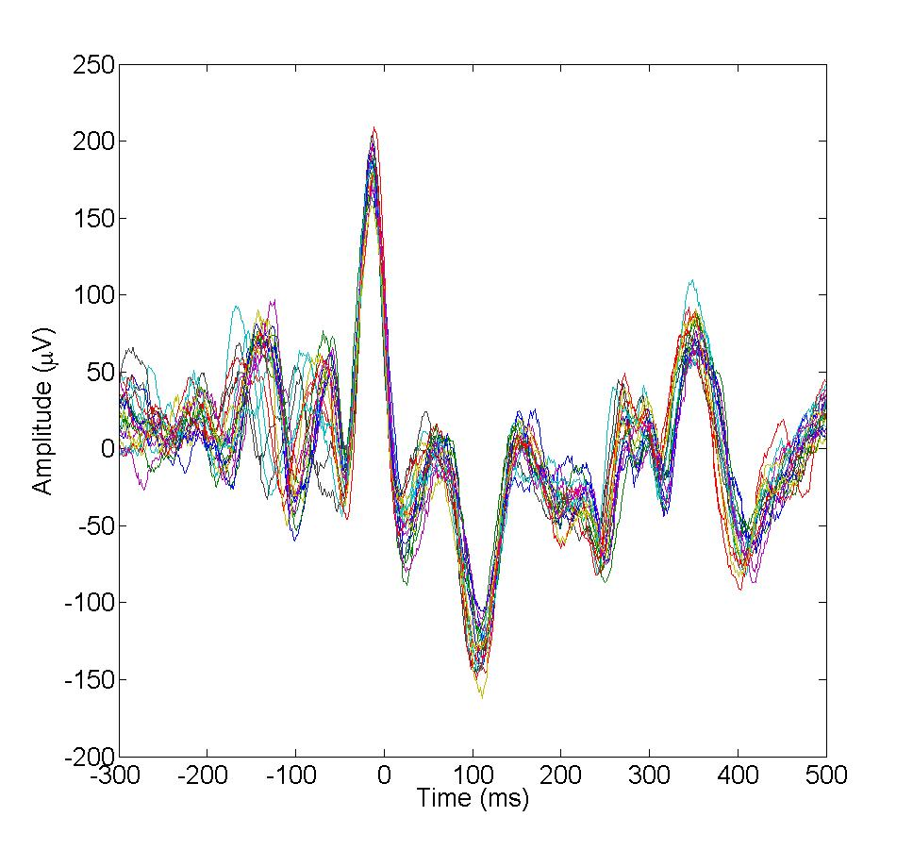
Interactions between EEG and MRI
Cardioballistic artefacts
What is it?
Cardiac-related motion of electrodes and wires in B₀:
motion of the head after each heartbeat
pulsation of scalp arteries
Hall effect due to blood flow (electrically conducting fluid in B₀ induces a voltage)
20 consecutive Cardioballistic Artifacts
Properties
non-stationarity: duration and amplitude is very variable between heart beats
does not affect each electrode identically (depends on electrode orientation in B₀)
delay between heartbeat and artifacts (~200ms) due to blood flow
proportional to B₀

Slide 12
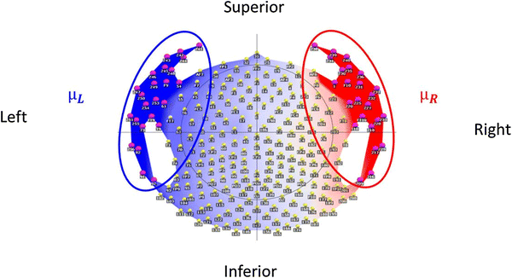
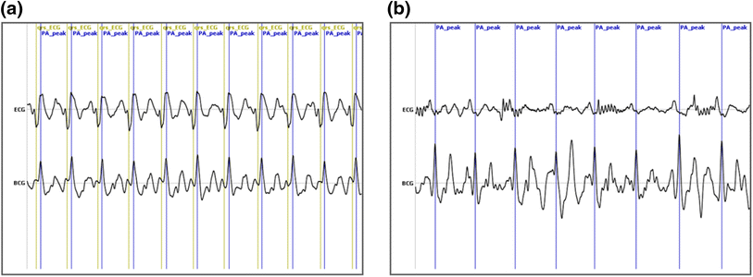
Interactions between EEG and MRI
BCG:
Strong polarity inversion between left and right temporal electrodes
Estimation of BCG from a subset of temporo-facial electrodes
Detection of ballistocardiogram (BCG)
With ECG
Deformation of QRS complex in B₀
Delay between ECG and BCG
Increase safety risk
BCG=μ_{R}−μ_{L}
Topographic map of pulse artifact
Iannotti et al., Brain Topograhy, 2015

Slide 13
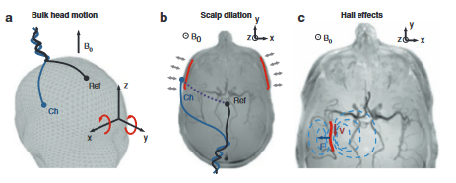
Pulse Artefact (PA)
PA supposed causes
Bulk head motion induced by the arrival of blood to the head
Pulsatile scalp dilation
Hall effects in the moving blood
PA issues
Spectrum : amplitude & spectral profile overlap with EEG neural signal
Time : high variability
PA variability (Jorge, Michel, 2019)
Head motion
Respiration
Heart rate fluctuations
(Figuereido, 2023)
Notes:
Hall effect blood flow
Conductive current artefact en surface
ballistocardiogram (BCG) artifact, a high-amplitude artifact locked to the cardiac cycle.
Not only its amplitude but also its spectral profile (with frequencies related with the heart rate, around 1 Hz, and its harmonics) considerably overlap with EEG signals of neuronal origin, particularly in the delta and theta frequency bands but also possibly extending into the alpha band.
Aside from the PA waveform itself, others have also found important variability in the PA timing, i.e., the time difference between each cardiac depolarization (ECG) and the resulting PA occurrence
As BCG artifact occurrences are approximately time-locked to cardiac activity, AAS can be applied by averaging the EEG data epoched across successive cardiac cycles²⁹. However, this method cannot take into account the large variability of the BCG artifact shape in any single EEG channel. To account for this problem, an optimal basis set (OBS) approach was proposed as an extension of AAS³⁶. Specifically, principal component analysis (PCA) is applied to EEG segments time-locked to the cardiac events, and the first components are used for adaptive artifact removal³⁶. An open issue in the use of OBS is the selection of the number of principal components (PCs) to be removed from the EEG data. The first 3 or 4 components are typically removed when using OBS, but there is no consensus on whether this can yield satisfactory results for all channels of the same dataset and for all datasets³⁷. Also, the performance of OBS is hampered by the fact that events for data epoching are typically identified on a simultaneously recorded ECG signal, assuming a fixed delay between the cardiac event and the artifactual occurrence in the EEG recording. The variability between ECG and BCG events^{38,39,40} may therefore have negative impact on the OBS performance.
Independent component analysis (ICA), a signal processing technique that can recover independent components (ICs) that are linearly mixed in a set of simultaneously recorded signals⁴¹, has also been proposed for the removal of the BCG artifact in multi-channel EEG data collected during fMRI scanning^{32,42}. Following ICA, the components associated with BCG activity are either manually or automatically identified, and then subtracted with appropriate weights from the EEG data^{42,43,44}. A first challenge in the use of ICA is the definition of unanimous criteria for the selection of the artifactual components³⁷. Furthermore, ICA-based artifact removal may be sub-optimal when some ICs still contain a mixture of neural activity and artifacts^{43,45}. This may happen when dealing with BCG artifacts, which are characterized by varying spatial topography across time^{30,32,38}. In this case, the basic ICA assumption of instantaneous mixture of ICs is clearly not fulfilled, as the BCG events are not perfectly aligned in time. This problem is present in any EEG dataset collected during fMRI scanning, but it can be particularly appreciated when using high-density EEG montages, which have large scalp coverage³⁸.

Slide 14
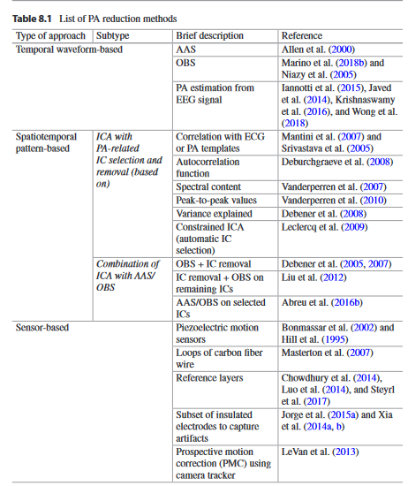
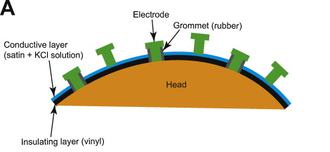
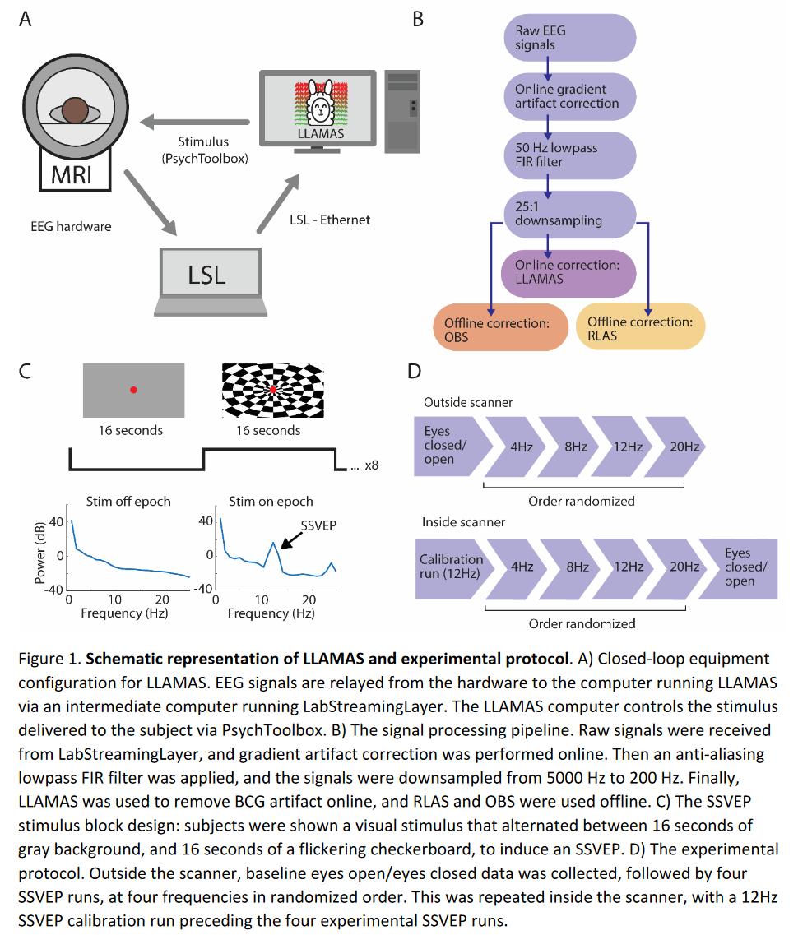
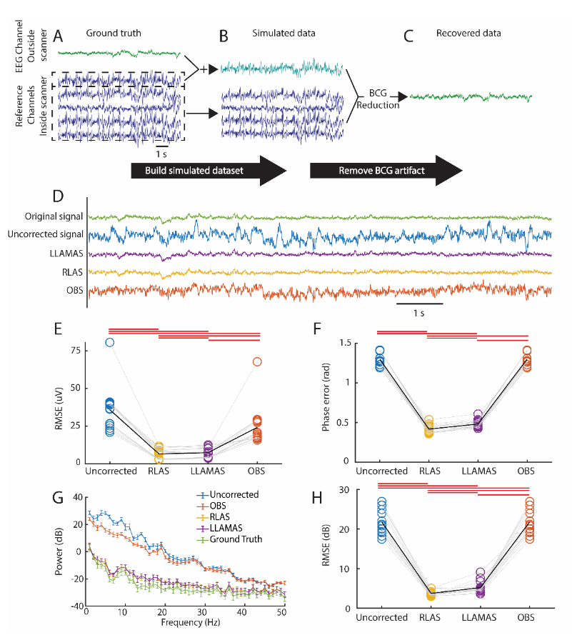
PA - benchmarking
PA correction (Figuereido, 2023)
Temporal waveform-based : AAS, OBS
→ Pb temporal instability of PA
Spatiotemporal based : ICA
Pb non-stationarity of PA sources
Sensor based : Reference layer
Sensor-based PA correction with Kalman filter
Kalman filter : predicts the next state of the artefact…
Error covariance matrix depending on insulated references channels
Filtering performed per channels
Advantages :
Information independent from neural signal
Sensitive to PA variability
DOES NOT require accurate PA triggering
Has low-latency (real time application)
Disadvantage : not all PAs captured, Hall effect still present
EEG-LLAMAS (Low Latency Artifact Mitigation Acquisition Software) uses Kalman filter with reference layer
Notes:
Do not speak, just mention it, hardware
Onne slide all the problem, not that much time
Grouiller et al. (2007) found that AAS was the method of choice if highly accurate R-peak detection was achieved.
The power of the Kalman filter lies in the effect that it predicts the next "state" of the signal/object by using an internal model of the process. That why it is very effective for physical processes, because they can (often) be modelled with quite large precision.

Slide 15
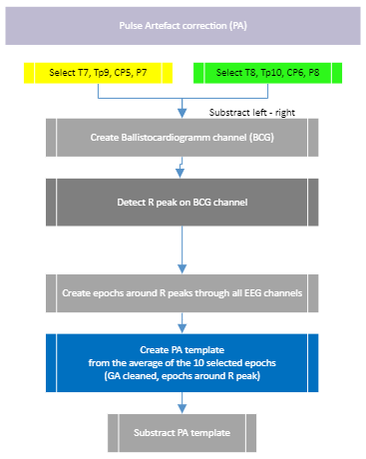
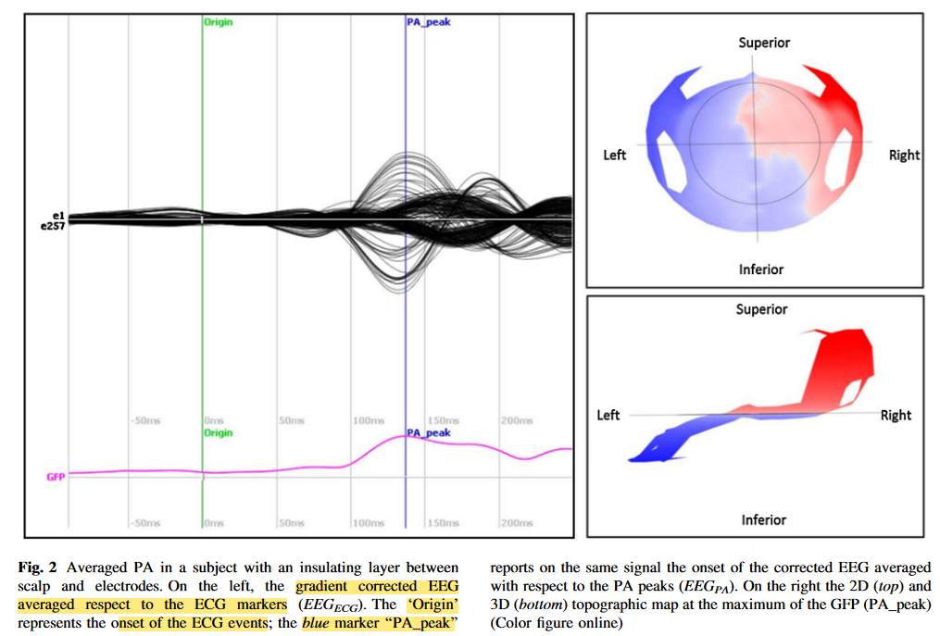
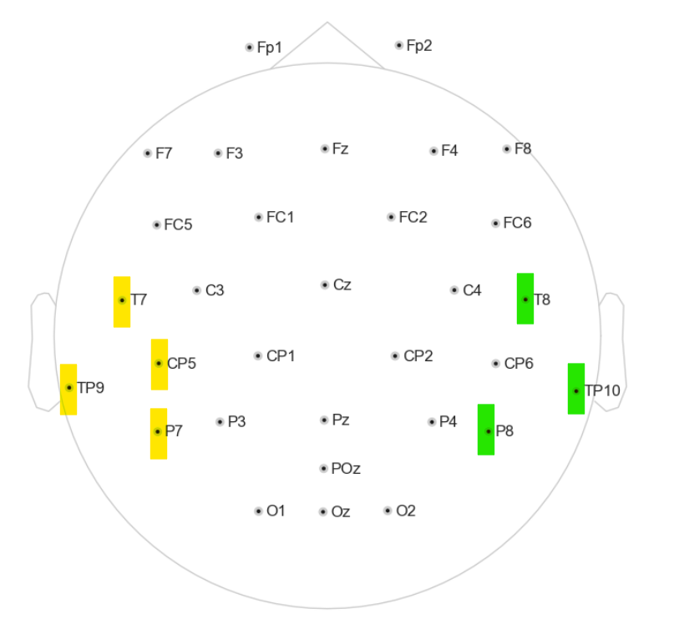
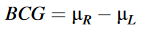
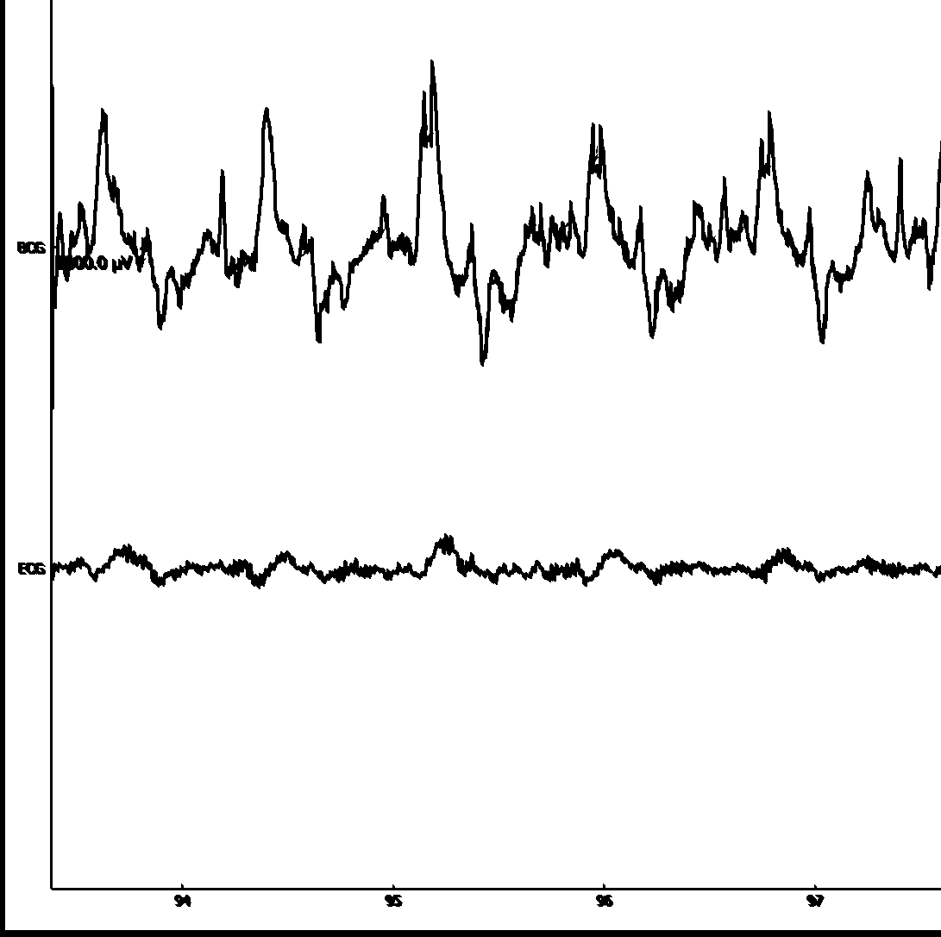
Ballistocardiogramm (BCG)
(Iannotti, 2015)
Construction of a BCG channel (Iannotti, 2015)
Need to find an algorithm for reliable R peaks detection….
Time (s)

Slide 16
PA correction
Robust ECG R-peak Detection Using LSTM Juho Laitala
https://github.com/jtlait/ecg2rr
https://numba.pydata.org/
Video lstm
https://www.youtube.com/watch?v=OJzF1HNVopk
See doc https://github.com/Soraya28/NeuXus/blob/doc/neuxus/nodes/correct.py*

Slide 17
LSTM - PA
Trained 6 females, 32 min of cognitive tasks
10 epochs with 40 batch of 256 windows of 2 s
For PA – GA validation, how many sub not mentinned
Cf https://github.com/jtlait/ecg2rr
PA :
normalizing ECG : Normalize a signal between the lower (default 0) and upper bound (default 1)
predict R peaks : probability of R peak at each time point, if too closed to window not considered

Slide 18
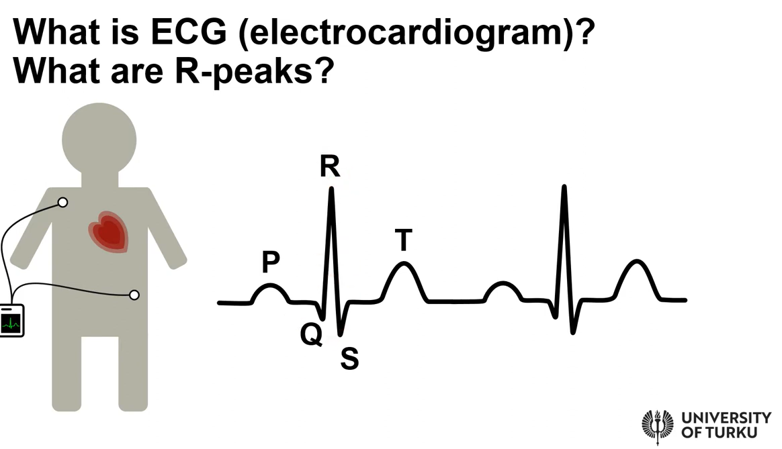
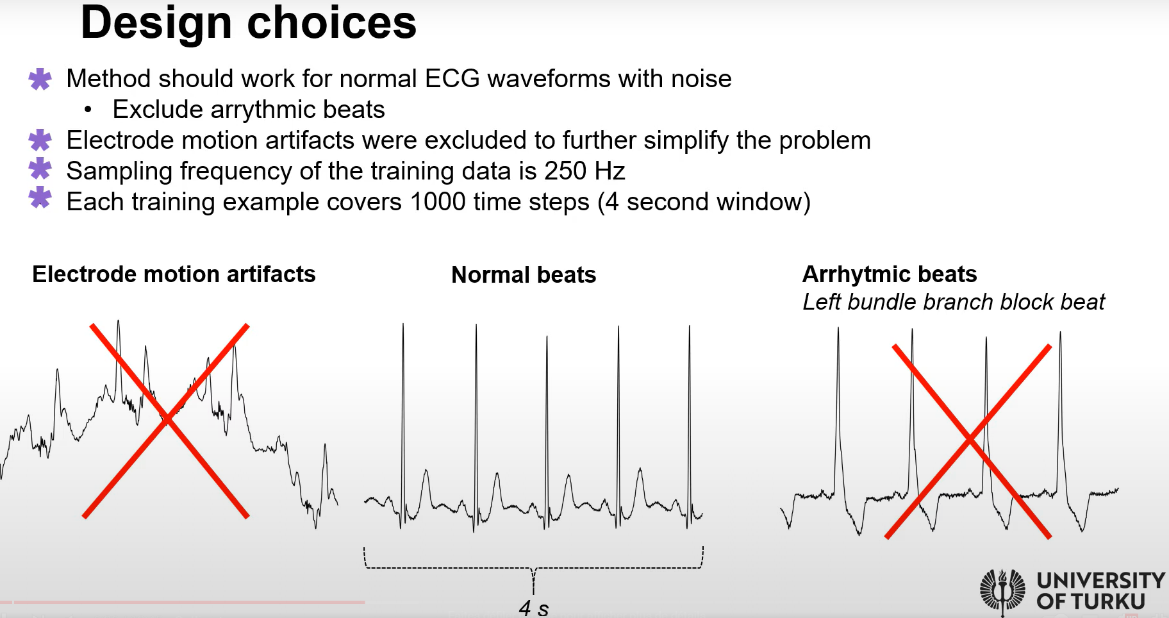
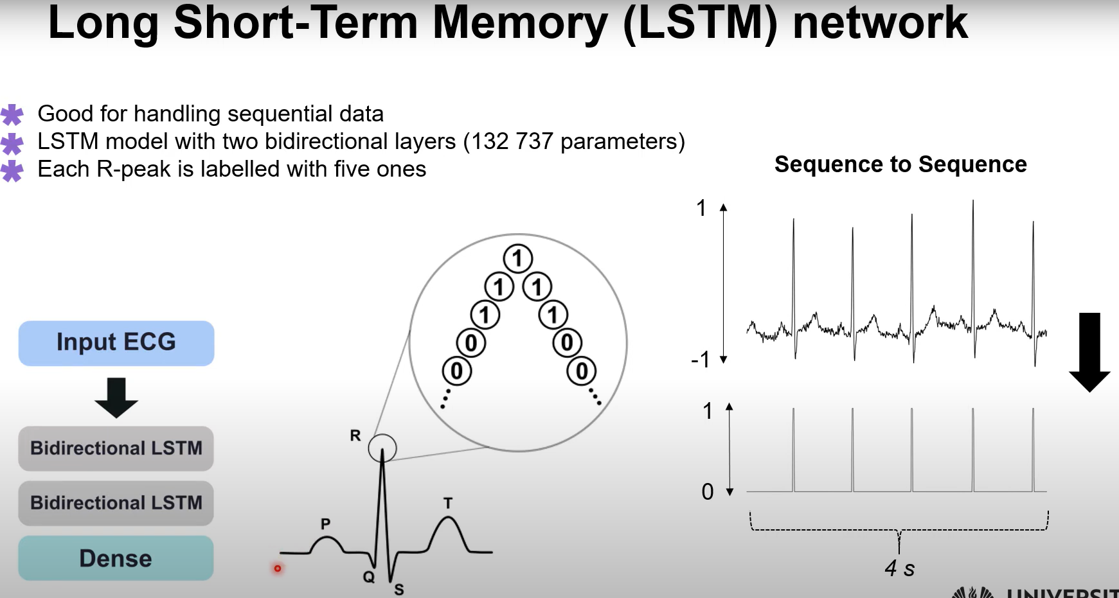
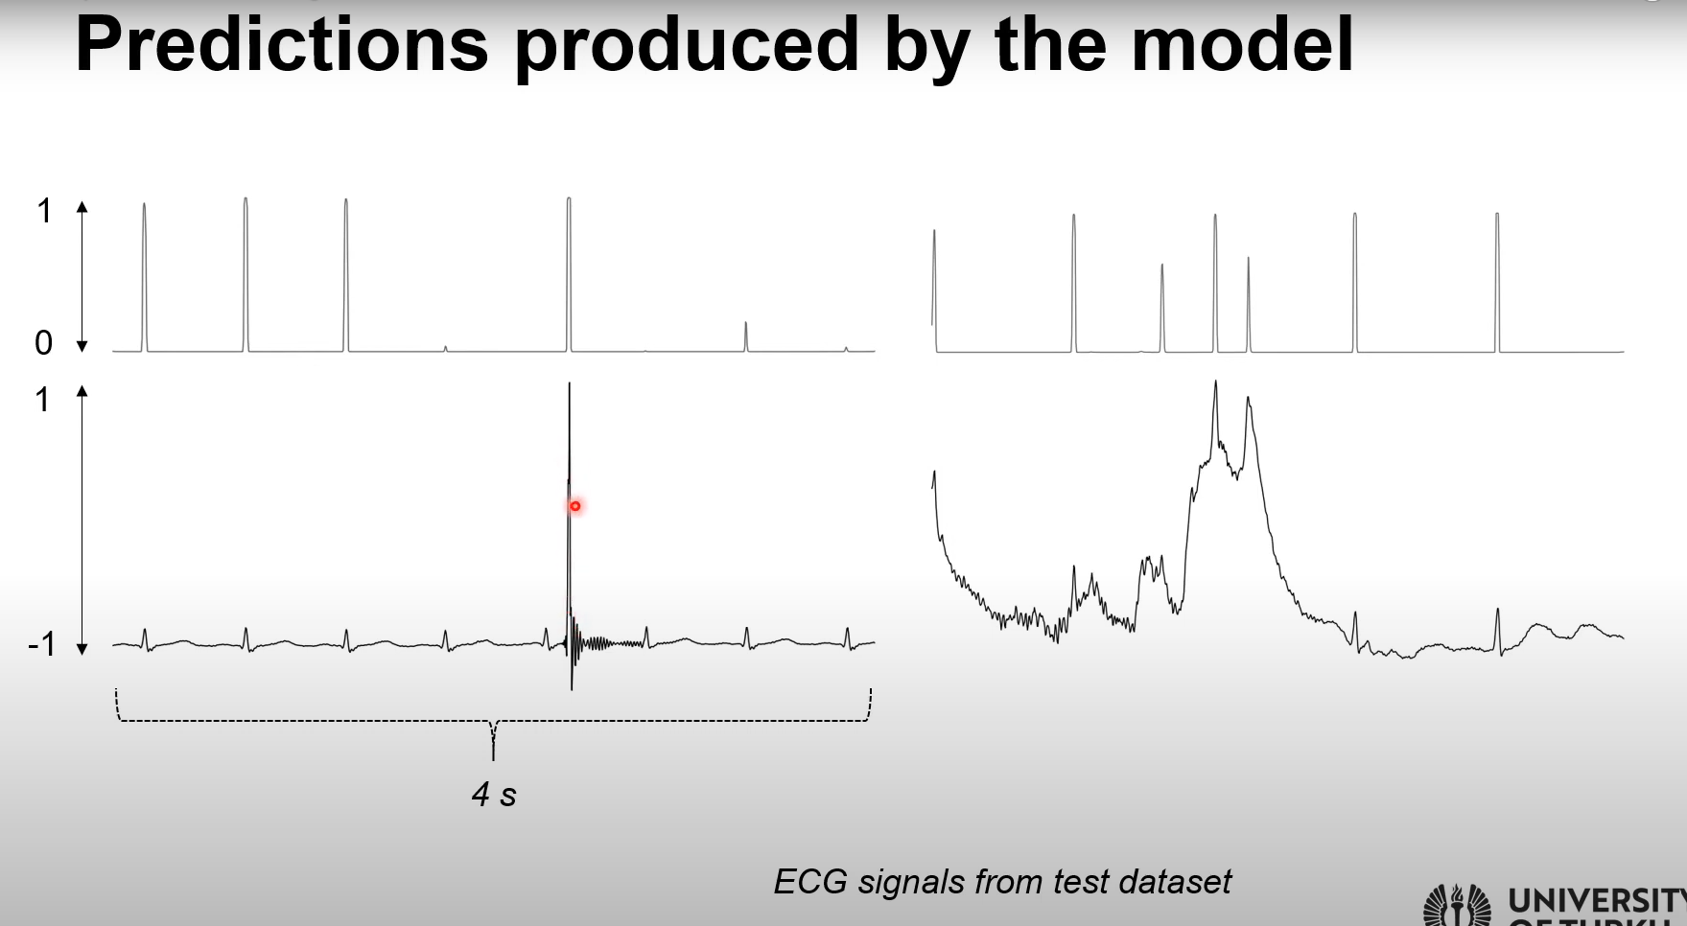
Issue if ECG noisy
ECG database
BW baseline, drift
MA motion artefact → BW + MA, or just one of them
60 Hz sinwave, simulates interference
Normal not arythmic
Adding noise
Normalize to -1, 1
LSTM good for sequential data
For each timestep, proba to be an R peak
If 5 or more predictions got high proba assign to Rpeak
Electrode contact noise
False positive

Slide 19
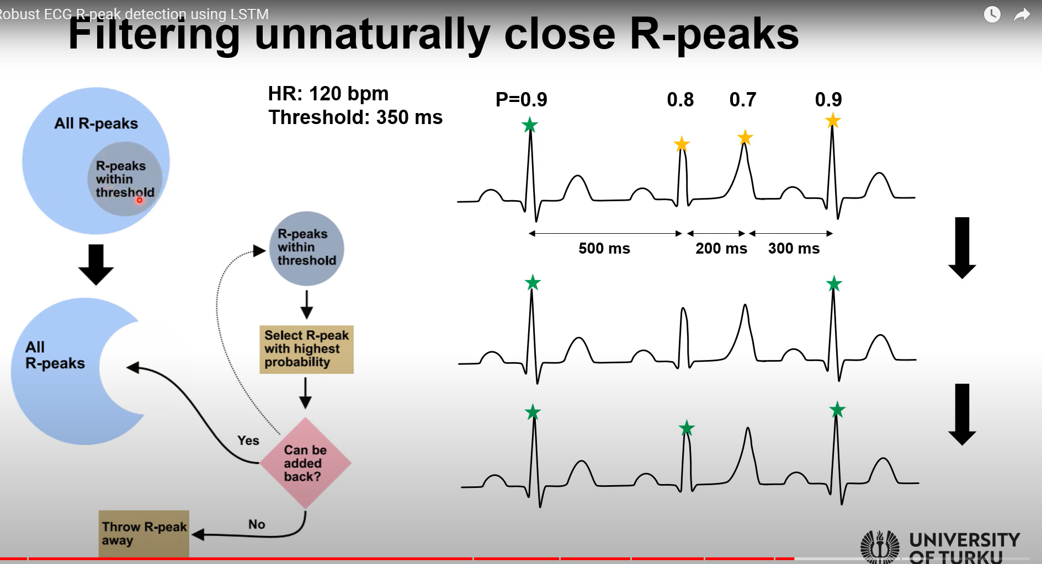
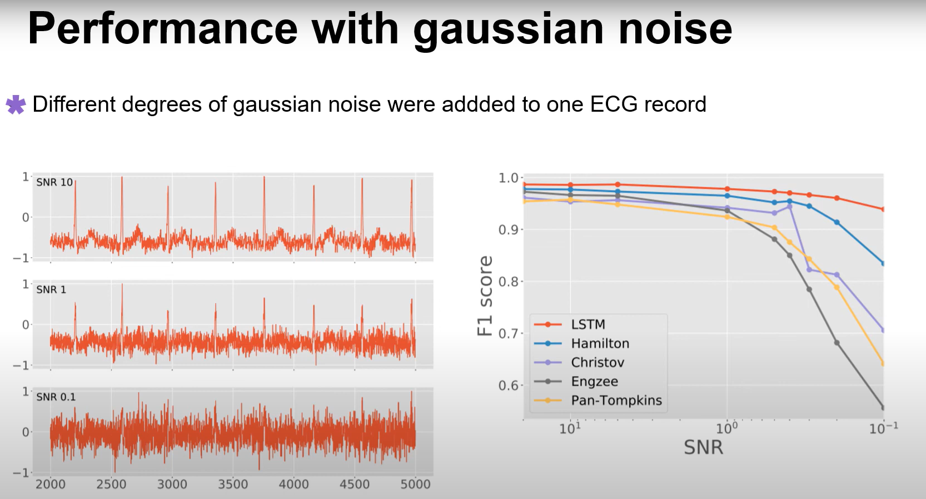
For false positive, filtering
If threshold 350ms, will substract some R peaks if distance between R peak is less than thresh
Final output, all R peak are away from at least thresh
might need to set up adaptive threshold if ECG really noisy
Performance of the new method

Slide 20
DF to raw mne
https://github.com/LaSEEB/NeuXus/blob/81d1779c02e8dcda0236f2698f9490799714598f/neuxus/node.py#L46
https://mne.tools/stable/auto_tutorials/simulation/10_array_objs.html#sphx-glr-auto-tutorials-simulation-10-array-objs-py
class Print(Node):
__init__(self, input_port):
Node.__init__(self, input_port, None)
update(self):
for chunk in self.input:
print(chunk)
[DEBUG] Input chunk of LslSend5 Fp1 Fp2 F3 ... TP10 POz ECG 1.252 23.297847 47.552322 14.224421 ... 7.896810 8.793040 -15314.381975 1.256 25.049095 46.881048 11.444911 ... 9.364090 8.881568 -15315.963226

Slide 21
Viewer
https://github.com/labstreaminglayer/App-LabRecorder
https://fcbg-hnp-meeg.github.io/bsl/dev/command_line.html#stream-viewer
Do not know how to have marker and signal at the same time, may be possible

Slide 22
Comparing EEG with EEG MRI
biosppy.plotting.plot_ecg(ts=None, raw=None, filtered=None, rpeaks=None, templates_ts=None, templates=None, heart_rate_ts=None, heart_rate=None, path=None, show=False)[source]

Slide 23
VENV
CREATION
In the command line:
> python -m venv "C:\Users\EEG\Desktop\NeuXus online correction\env\neuxus-master"
ACTIVATION
> "C:\Users\EEG\Desktop\NeuXus online correction\env\neuxus-master\Scripts\activate.bat"
INSTALLING NEUXUS
(env-example) > pip install git+https://github.com/LaSEEB/NeuXus
USING NEUXUS
(env-example) > neuxus script_example.py
DEACTIVATION
(env-example) > deactivate
USING NEUXUS FROM BATCH FILE
If using run_script_cor.bat, right-click it, choose edit, and replace "C:\Users\EEG\Desktop\NeuXus online correction\env\neuxus-master\" with the path to the env you created!
Then, to run the correction, just double-click run_script_cor.bat

Slide 24
Original guidelines

Slide 25
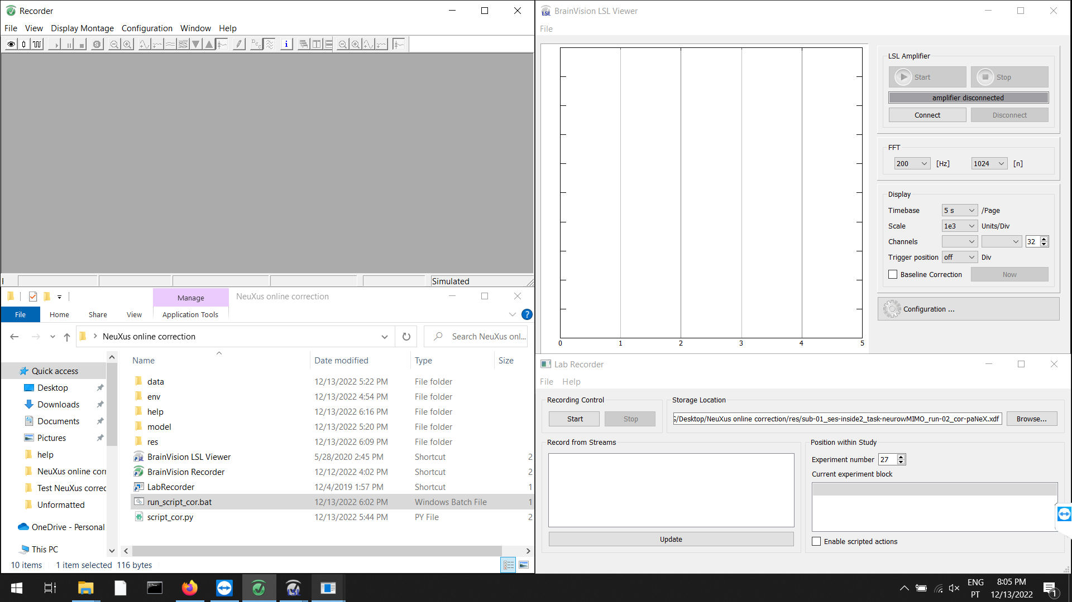
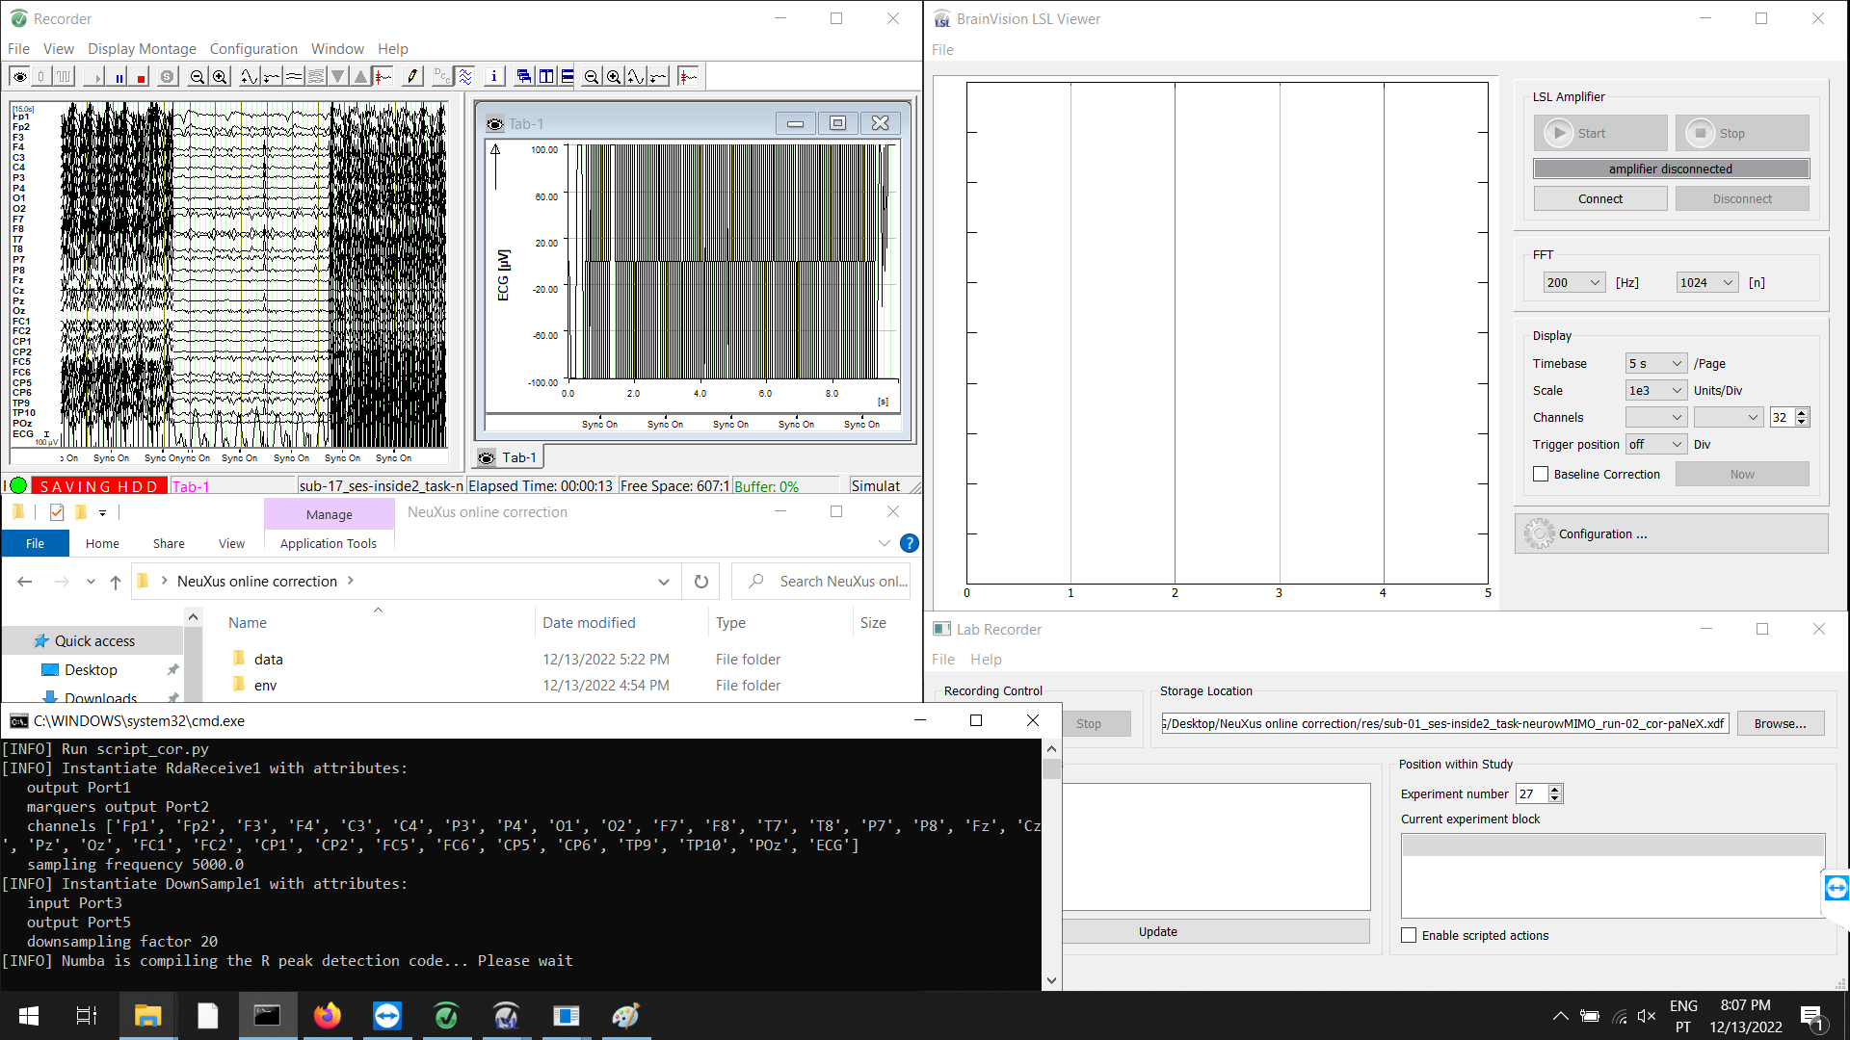
Before the fMRI acquisition starts:
# Make sure Triggerbox is connected:
- the scanner's fiber optic cable should be connected to FOV, the output pins switched to PC, and the "Bit 15 stretch" pin switched to "5 ms"
1. In the EEG laptop:
- Open Recorder
- Open the "NeuXus online correction" folder
- Open LSL Viewer
- Open LabRecorder
2. In Recorder:
a) In "File > Edit Workspace": set the raw file folder to "C:\Users\EEG\Desktop\NeuXus online correction\res"
b) In "File > Edit Workspace": set the name of the file appropriately (continue to save changes)
c) Start monitoring
# Make sure Syncbox is connected (Recorder must be receiving "Sync On" markers)
d) Start recording
3. In NeuXus online correction folder:
a) Open run_script_cor.bat
b) A command window will pop up. Wait (< 60 seconds) until it shows: "[INFO] Run pipeline". Then, NeuXus should start streaming by LSL
3. In LSL Viewer:
a) Connect to "signal_pa" and "markers_pa" streams
b) Press start

Slide 26
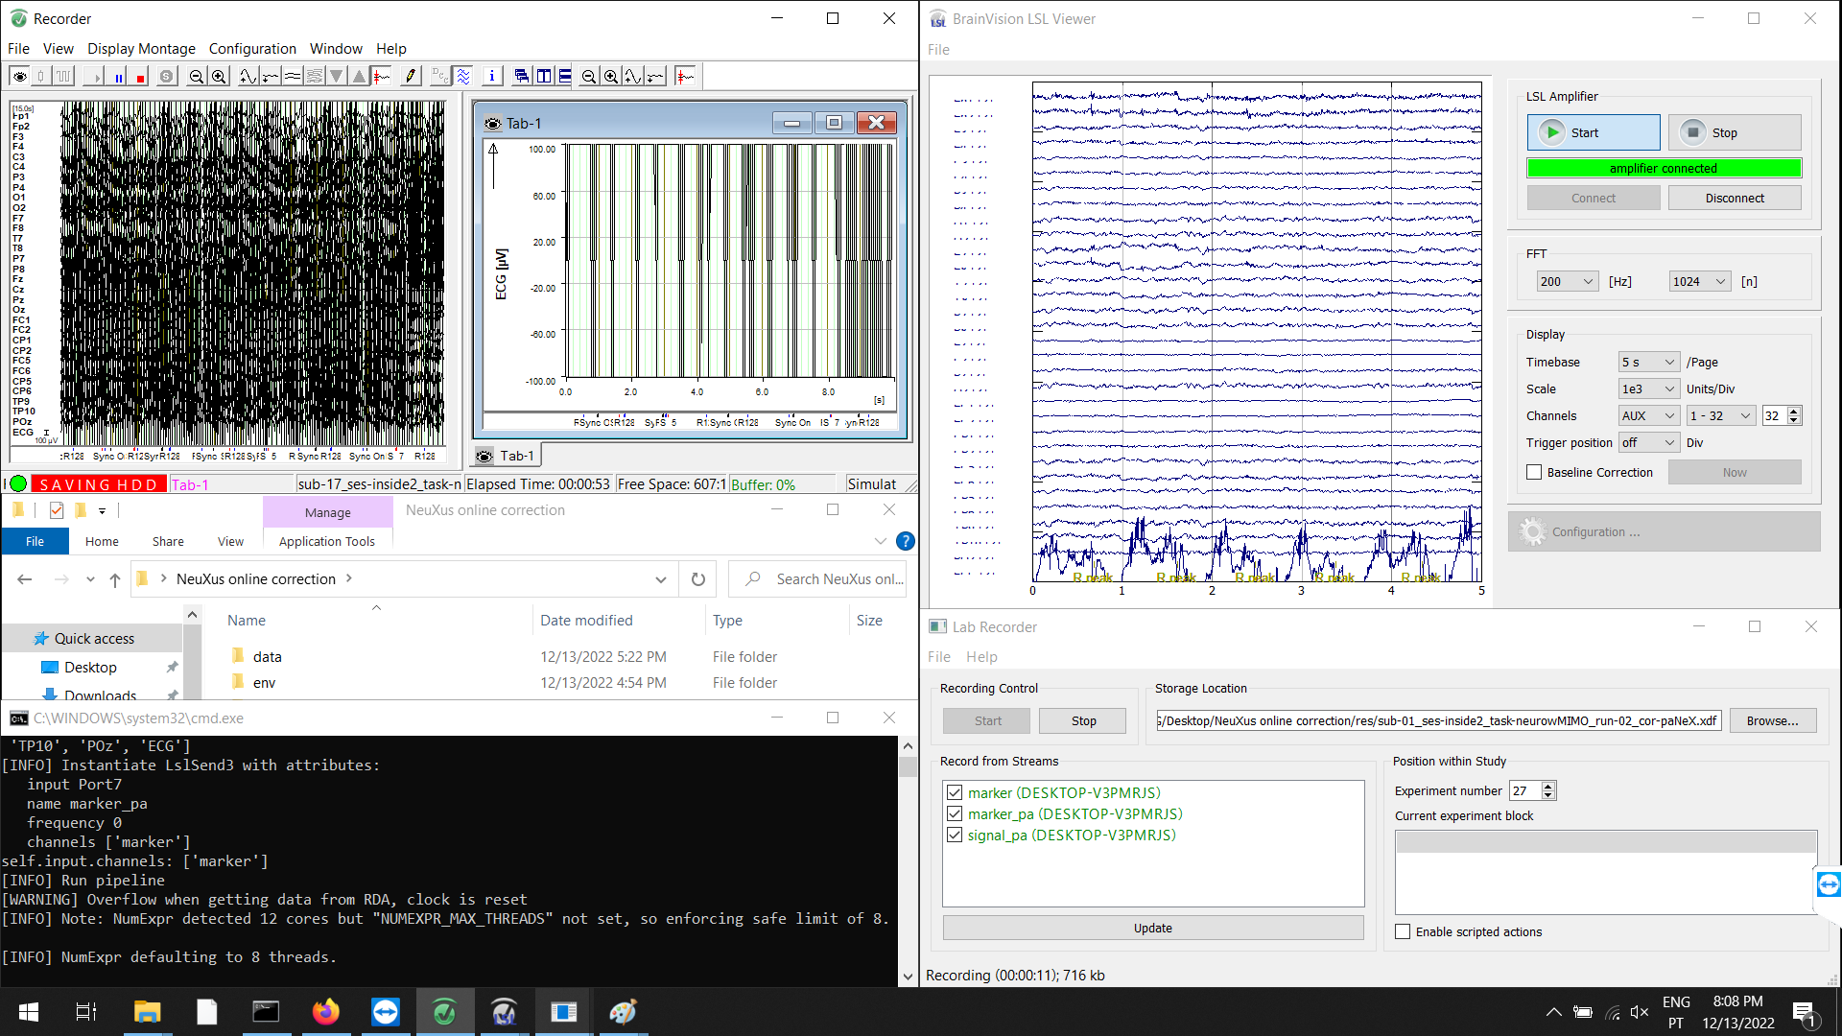
4. In Lab Recorder:
a) In "Storage location": set it to "C:/Users/EEG/Desktop/NeuXus online correction/res/sub-01_ses-inside2_task-neurowMIMO_run-02_cor-paNeX.xdf"
b) In "Record from streams": select "signal_pa", "markers_pa" and "markers" (one more stream than in LSL Viewer)
c) Press Start
5. Start the fMRI sequence
6. In LSL Viewer, check if the signal eventually becomes corrected (< 30 seconds)
# If it does not, check if Recorder receives the R128 marker at every volume
When you decide to end the acquisition: (or if there is any error)
1. In Lab Recorder: press Stop
2. In LSL Viewer: press Stop, and Disconnect
3. In the NeuXus command window: press ESC
4. In Recorder: stop recording, and stop monitoring
5. Stop the fMRI sequence

Slide 27
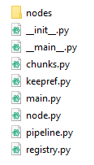
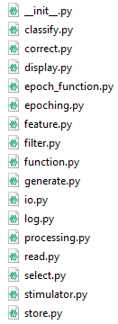
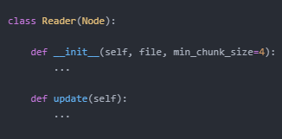
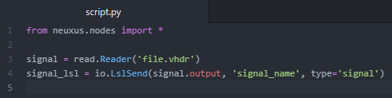
How to use it
1. Install Python
2. Install NeuXus
3. Write a script
4. Execute it with keyword: neuxus
2.
3.

Slide 28
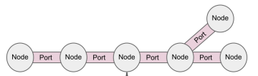
How to use it
1. Install Python
2. Install NeuXus
3. Write a script
4. Execute it with keyword: neuxus
2.
3.
node
port

Slide 29
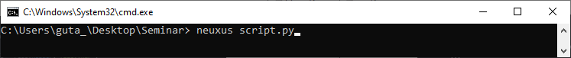
How to use it
1. Install Python
2. Install NeuXus
3. Write a script
4. Execute it with keyword: neuxus
2.
3.
4.

Slide 30
How to extend it
1. Write/extend a node!
2. Push to github
.output
.update()
∞

Slide 31
How I extended it
EEG-fMRI
EEG Artifacts
Solution
GA correction
chunk template
PA correction
chunk template
GA template
Select
PA template
R-peaks
Select
Average
Average
Predict
Time
Channels
Subtract
Downsample
Filter ECG
Subtract
noisy chunk
clean chunk

Slide 32



An introduction to NeuXus: an open-source Python toolbox for real-time EEG processing
Gustavo Caetano
gmlcaetano@gmail.com
LaSEEB seminar
6 June 2022

